Slide 1
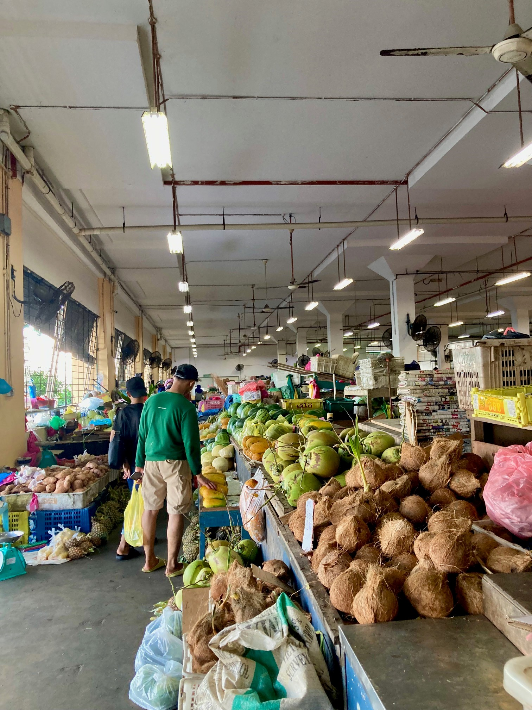
DIAGNOSTIC Tools for SUPPORTING FOOD SYSTEMS transformation

Slide 2
Tools to Support Food Systems Transformation
Global & Country Food Systems Dashboards - describe, diagnose and decide on food systems action
Countdown to 2030 - monitor progress in food systems change
Food systems policy coherence diagnostic - understand whether sectoral policies are aligned with goals
Initiative on Climate and Nutrition - identify opportunities for joint action on nutrition and climate
Financial Flows to Food Systems budgeting diagnostic (3FS) – see where food system financing comes from, and to what it contributes
Global Diet Quality Assessment – quickly assess what people eat around the world

Slide 3

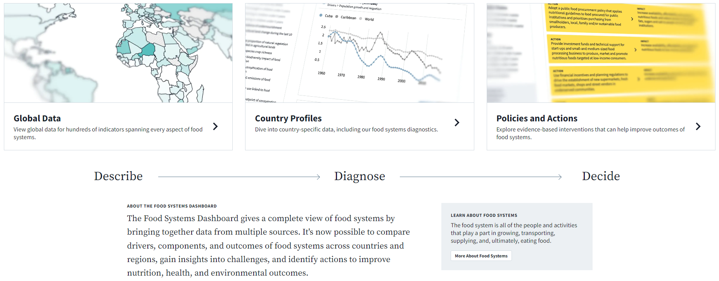
Global Food Systems Dashboard
Combines data from multiple sources to give users a complete view of food systems
Over 300 indicators from over 40 sources for 230 countries
  Compare food system
  components across
  countries and regions,
  or to global averages
View summaries of a
country’s food system
Identify and prioritize
action areas to sustainably
improve diets and nutrition + environmental sustainability
  https://foodsystemsdashboard.org
Notes:
Live demo: global + trends + country profiles (explain diagnose)

Slide 4
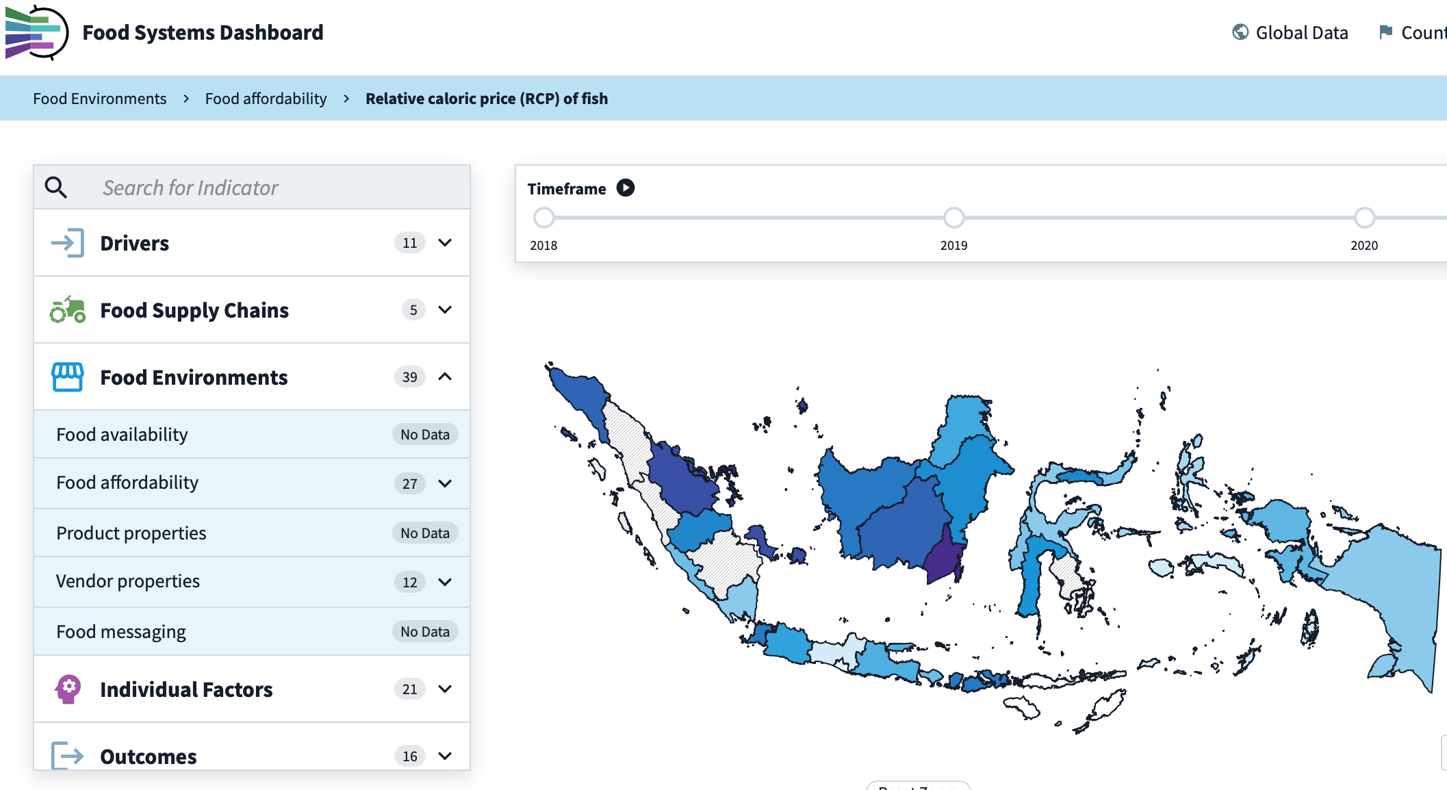
Country Food System Dashboards
Provide detailed data at subnational levels; developed in partnership with relevant ministries
Indonesia: Bappenas (Indonesian Ministry of Planning and Development) assumed management of their Food Systems Dashboard in June 2023. They will use it to develop their:
National Medium-Term Development Plan (RPJMN)
National Action Plan for Food and Nutrition

Slide 5
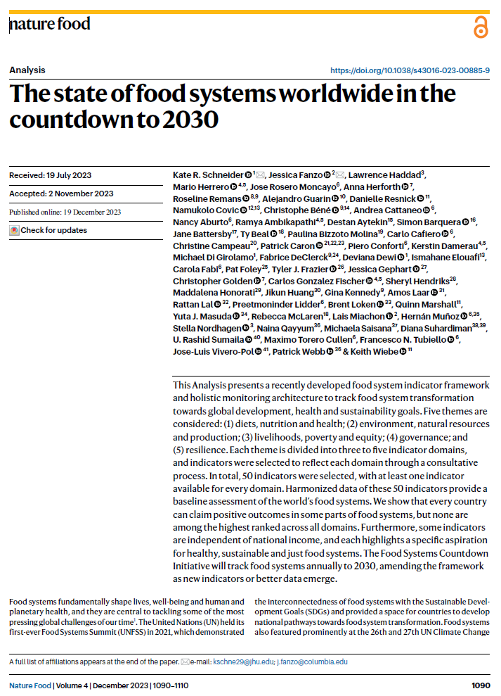
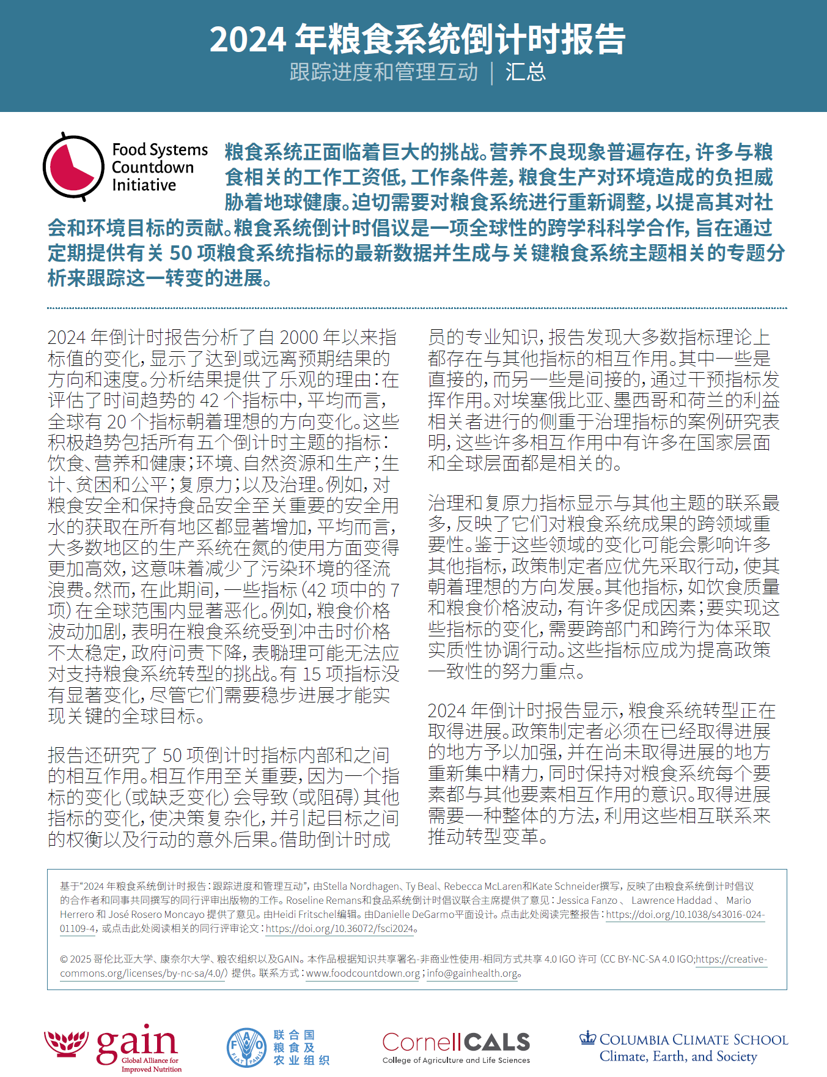
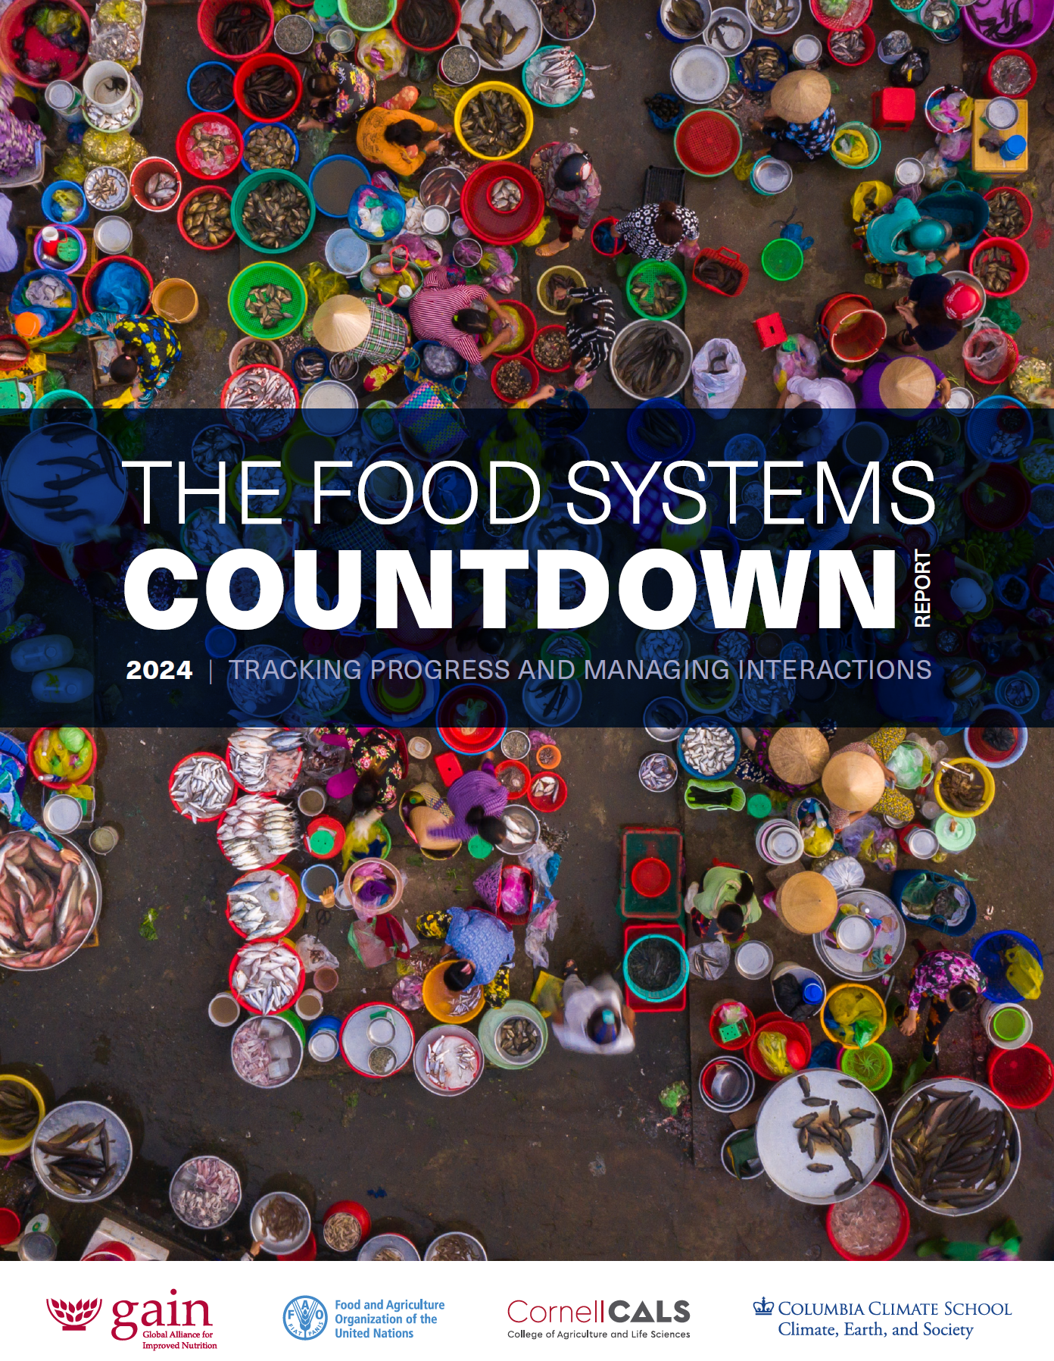
Food Systems Countdown Initiative
Science-based monitoring of progress in food systems change
An interdisciplinary, multi-institution global scientific partnership to monitor global food systems.
Comprised of over 50 researchers from over 30 institutions.
Tracks progress on about 50 indicators, covering 5 domains of food systems, through
  Annual peer-reviewed papers & reports
  Analyses of trends, interactions, and performance
  Country-level data integrated into the Food Systems Dashboard

Slide 6
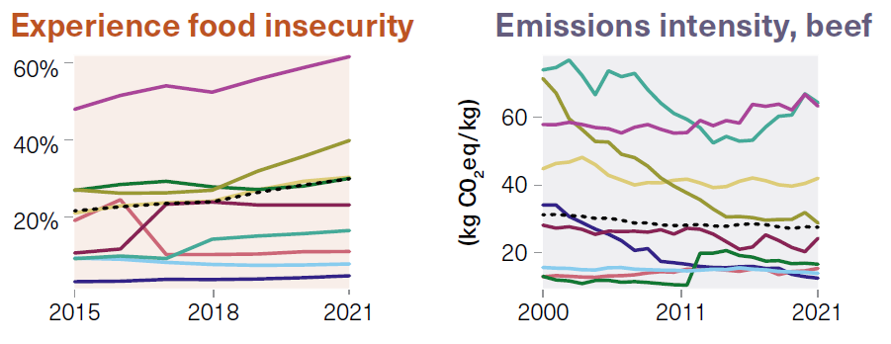
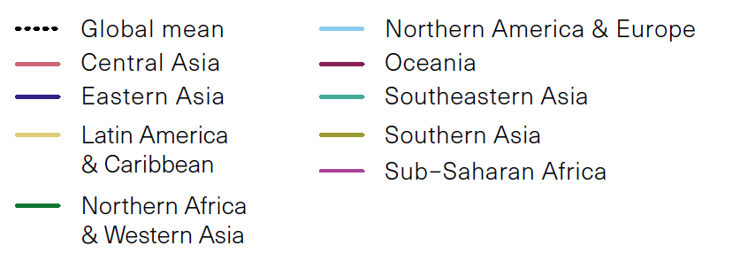
Food Systems Countdown Initiative
of 42 indicators examined, 20 changed in a desirable direction on average globally, though 7 have worsened

Slide 7

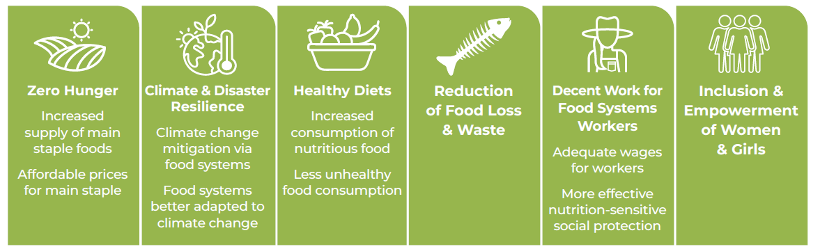
Food Systems Policy Coherence Diagnostic
An easy-to-use way to understand and diagnose policy coherence
Modular tool completed via document review, key informant interviews, and validation workshop:
Module 1 - A simple, rapid take on ways to foster coherence through governance structures and mechanisms.
Module 2 - Identifies how existing policies across six sectors contribute or detract from 10 policy goals
Applied to date in four Asian, six African, and two European* countries.

Slide 8
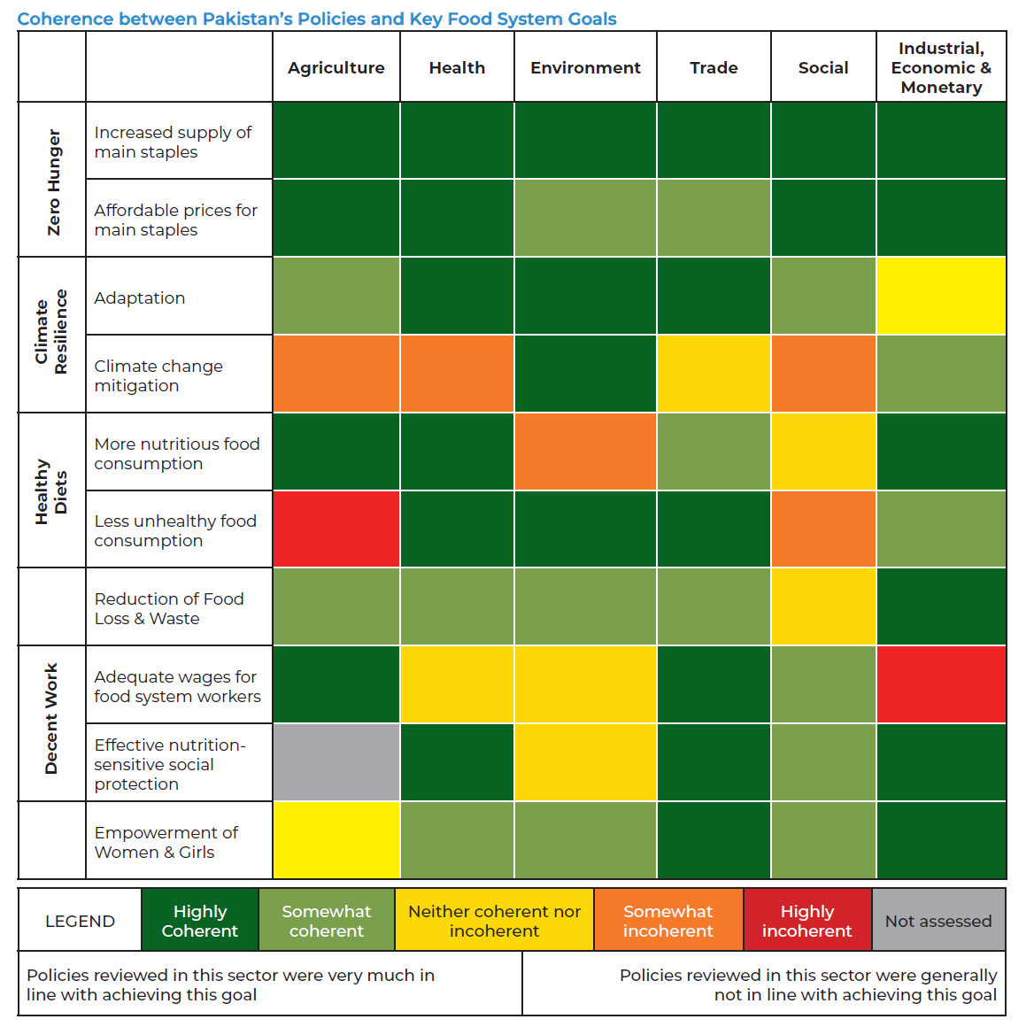
Example from Pakistan
  Module 1: Structures & Mechanisms
  Strong on framework documents. political commitment, inclusivity & stakeholder engagement
  Opportunities for improvement on capacity & implementation, coordination structures, and particularly monitoring & accountability
Module 2: (In)coherence among Policies
Strongest coherence: health & trade policies
Weaker coherence: agriculture, environmental, social policies

Slide 9

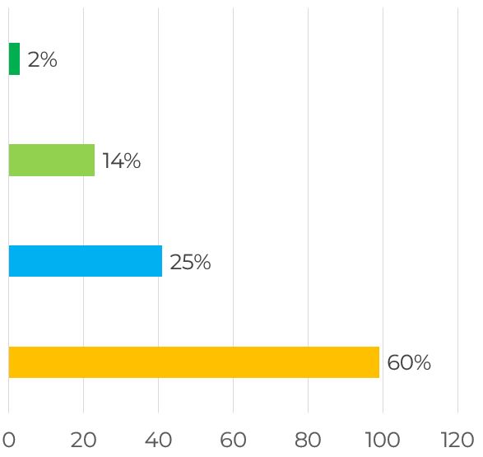
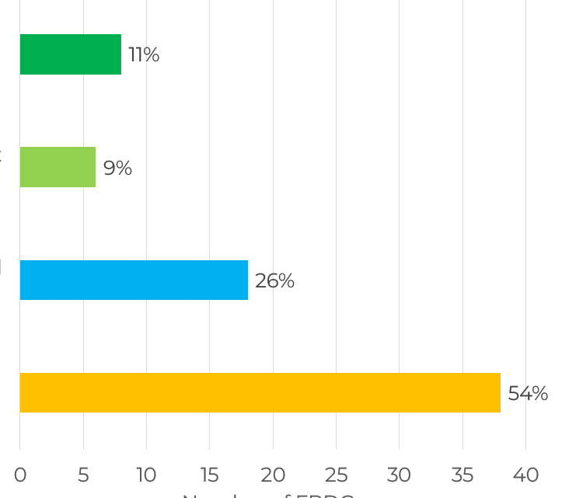
Initiative on Climate and Nutrition (I-CAN) Analysis
Where are the opportunities for integrated action on climate & nutrition?
Nutrition considerations in NDCs
Climate considerations in FBDGs
4: intentional connectedness, with commitment to mobilising resources, distinct plans to take action to connect climate & nutrition
1: No intentional connectedness

Slide 10
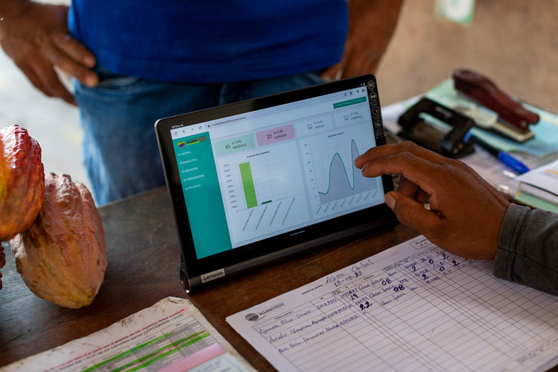
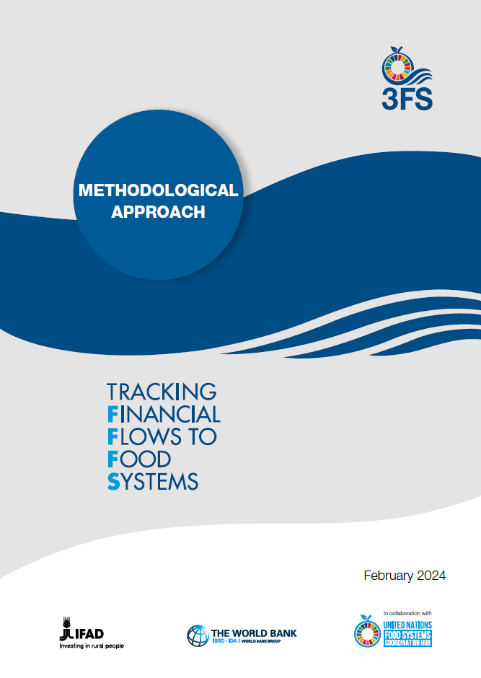













Where does food system financing come from, and to what does it contribute?

Slide 11

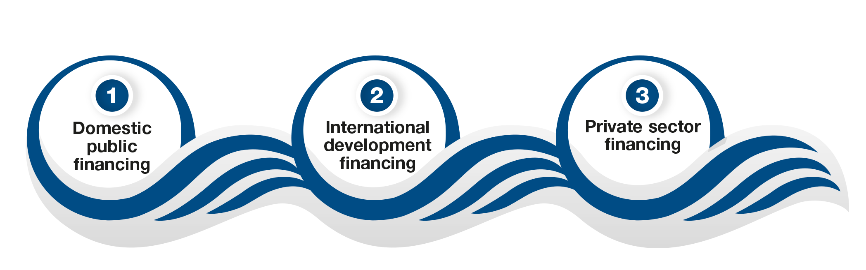
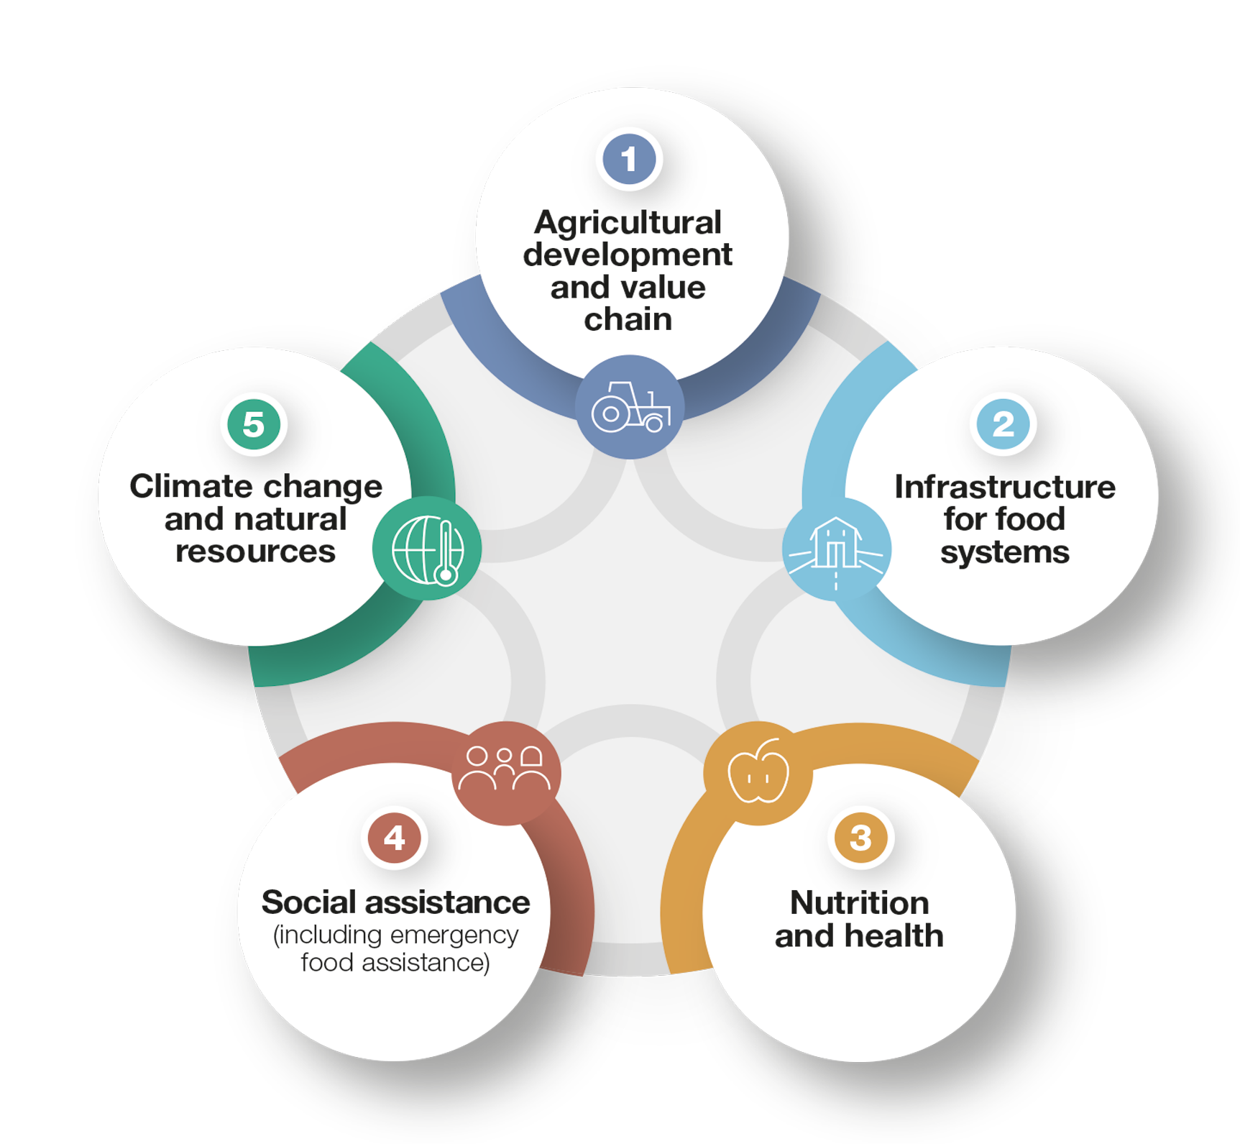


FINANCIAL FLOWS TO FOOD SYSTEMS
3 SOURCES OF FINANCING
5 FOOD SYSTEMS COMPONENTS
Applications in Bangladesh and Indonesia

Slide 12
Financial Flows to Food Systems (3FS) results from Public Expenditure

Slide 13

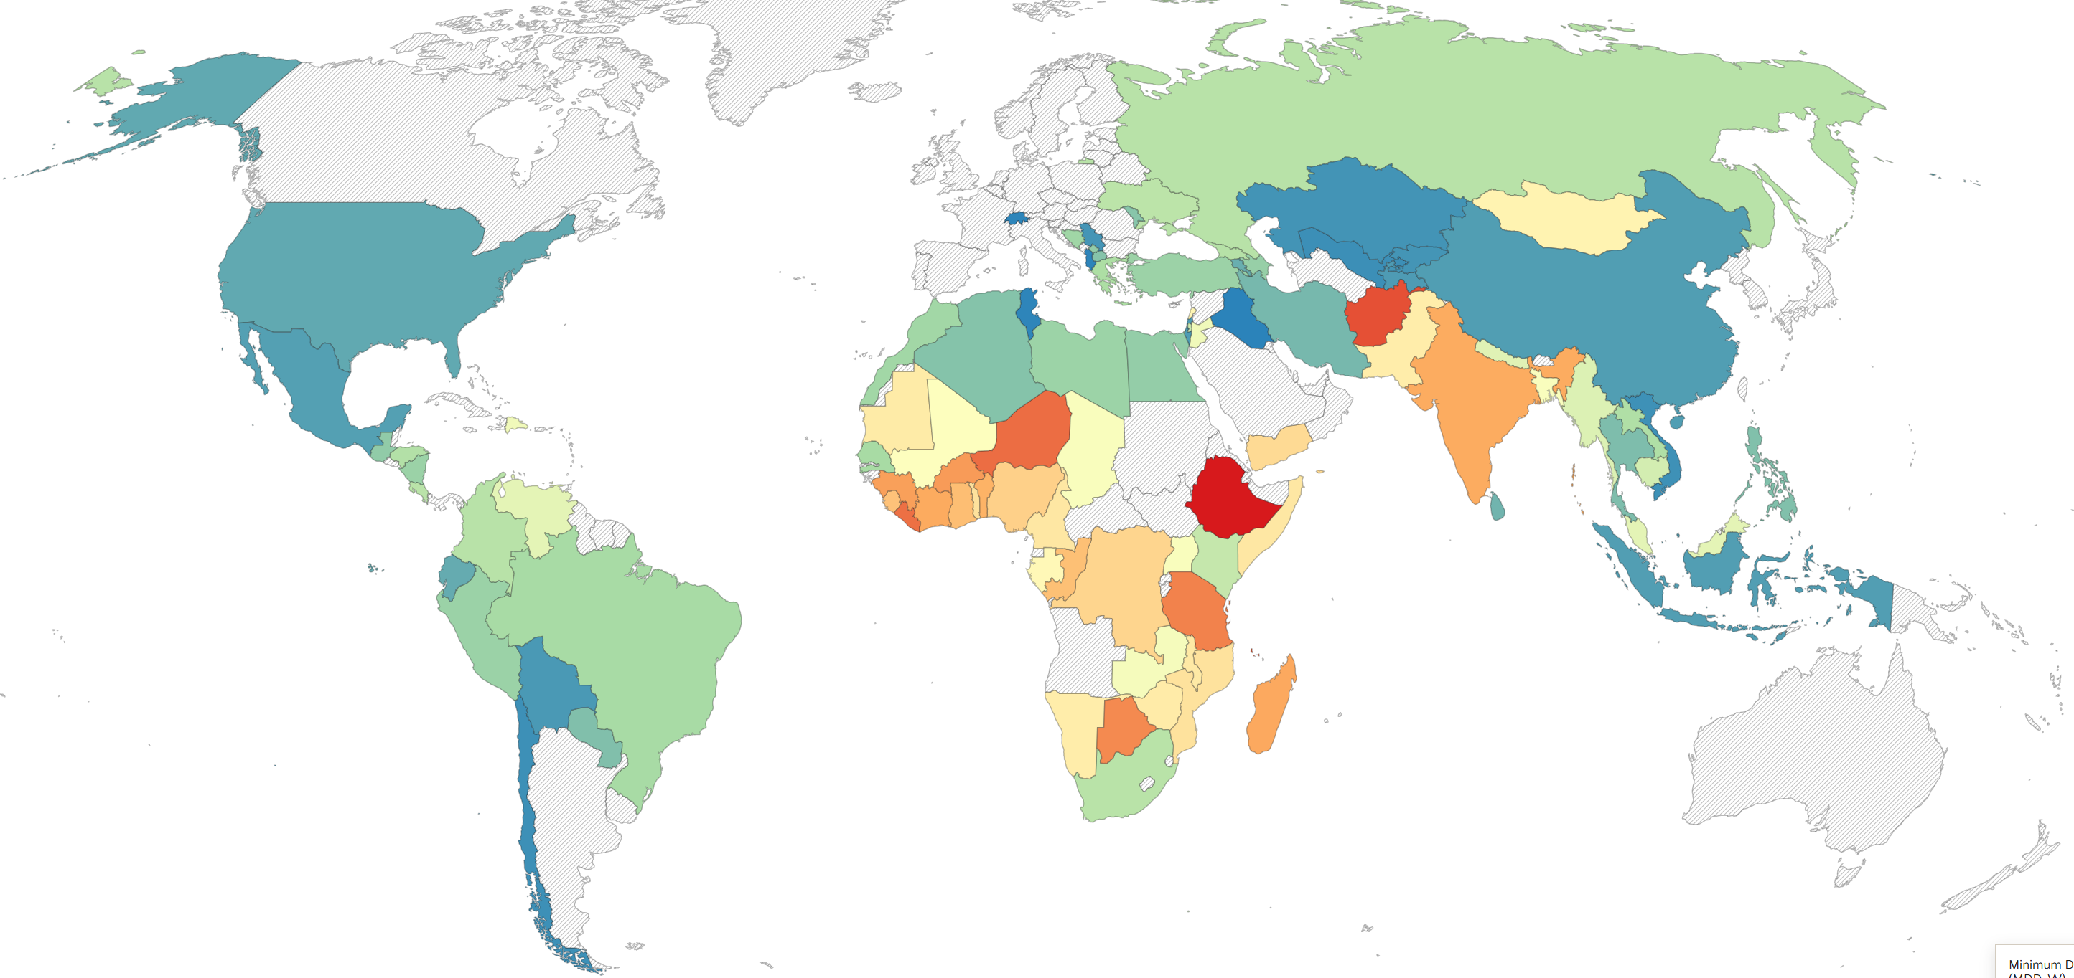
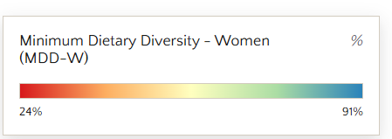
Diet Quality Questionnaire (DQQ)
Rapid, inexpensive approach to understanding what the world eats
29 yes / no questions
Questionnaire takes 10 minutes to complete
< 1% cost of typical National Surveys
Notes:
Country-adapted versions available for 36 Asian countries
30% in Afghanistan to close to 90% in Central Asia

Slide 14
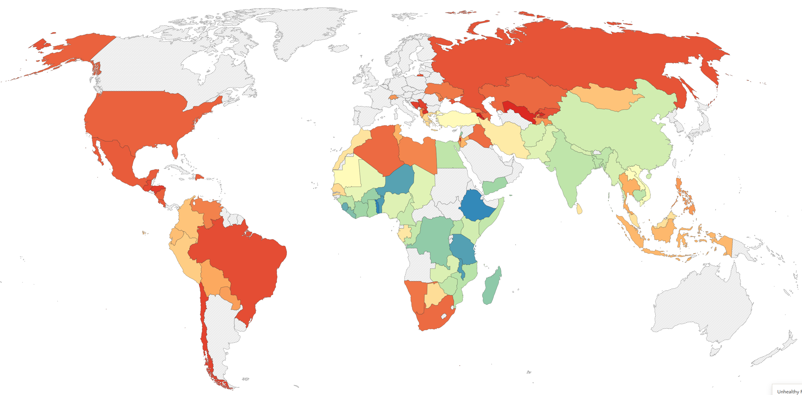
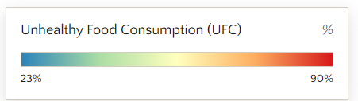
Diet Quality Questionnaire (DQQ)
Highlights growing burden of unhealthy diets associated with non-communicable diseases in parts of Asia
Notes:
Proportion of the population who consumed any of the following: (a) more than one sugary food or beverage or any soft drinks (including baked or grain-based sweets; other sweets; sweetened tea, coffee or milk drinks; fruit juice or fruit drinks; soft drinks); (b) more than one ultraprocessed salty food (including packaged ultraprocessed salty snacks, instant noodles, fast food, processed meat, or deep fried food); or (c) processed meat.

Slide 15
Where to Find the Tools?
Global & Country Food Systems Dashboards - https://www.foodsystemsdashboard.org/
Countdown to 2030 - https://www.foodcountdown.org/
Global Diet Quality Assessment - https://www.dietquality.org/
Food systems policy coherence diagnostic - https://www.gainhealth.org/policy-coherence-toolkit
Initiative on Climate and Nutrition -https://www.gainhealth.org/resources/reports-and-publications/initiative-climate-action-and-nutrition-i-can
Financial Flows to Food Systems budgeting diagnostic (3FS) – https://www.ifad.org/documents/d/knowledge/3fs-factsheet

