Slide 1
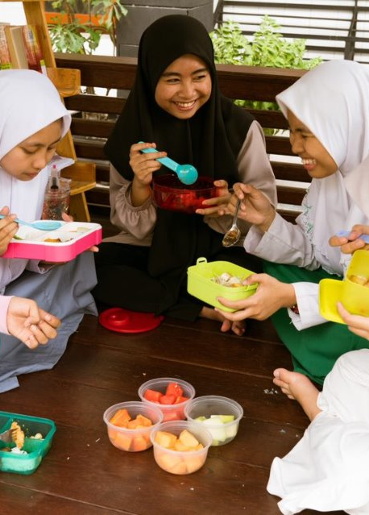
Youth and demand creation

Slide 2
Context – youth in Asia
60% of the global youth population lives in Asia.
Diets
Employment
Youth are facing a tripe burden of malnutrition: rising overweight/obesity alongside persistent undernutrition and micronutrient deficiencies.
South Asia carries the world's largest anaemia burden affecting almost half of adolescent girls and women.
A 2023 UNICEF survey of 7,500+ adolescents found packaged snacks, sugary drinks, and fast food now common in school food environments.
Rapid urbanisation is expanding access to, and marketing of, foods high in salt, sugar and fat to young consumers.
Mass migration to cities is signalling a looming rural labour shortage.
Agriculture is often not youth's first livelihood choice, even where it dominates local economies. Limited land, finance, and low pay push young people away.
In South Asia, cultural norms and discriminatory inheritance laws further exclude young women from leadership and land access.
Young people are migrating to cities faster than other demographics.
16-30% of youth in asia are NEET*
*This varies by country and is 2x higher for young women than men.
Source: ILO, UNFPA, FAO, UNICEF

Slide 3
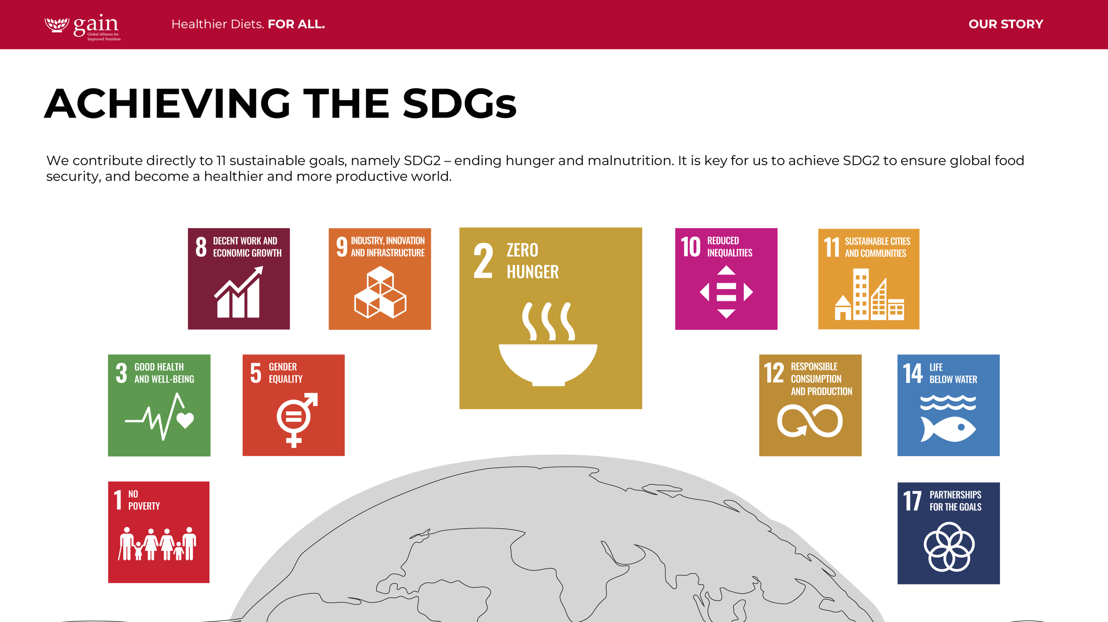
How GAIN works with youth in Food Systems
  GAIN promotes healthy eating habits, nutrition education, and access to nutritious foods.
  GAIN provides changemakers with opportunities for advocacy and leadership development.
  GAIN helps youth find decent work in food systems through skills development, access to resources and networks.
Changemakers
Aged 18-24
Consumers
Aged 10-19
Workers
Aged 18-35

Slide 4
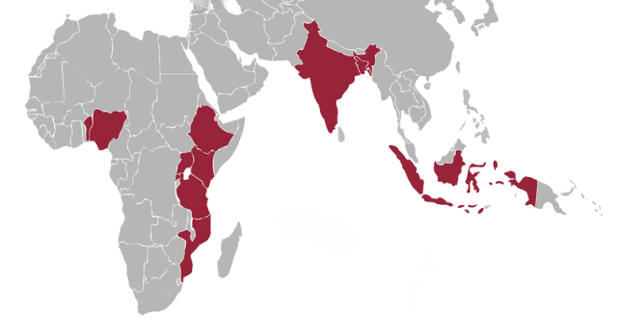
YOUTH WORK IN ASIA
Pakistan
Youth Voices
Adolescent Nutrition Policy
Indonesia
Food Investigator Game
Saya Pemberani
India
Youth Hackathon
Key:
Consumers
Changemakers
Workers
Bangaldesh
Youth Voices
Bhalo Khabo Bhalo Thakbo
Global Innovation Challenge

Slide 5

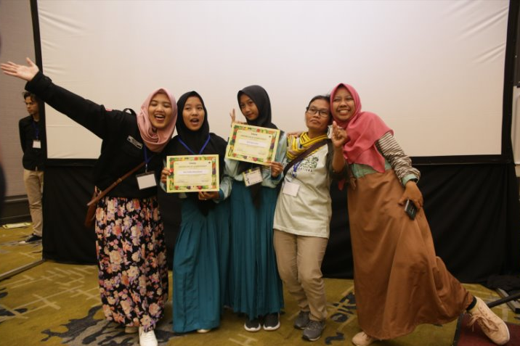
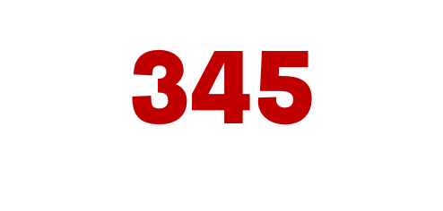
Youth as Consumers (Indonesia)
SAYA PEMBERANI
​
We invited and mentored adolescents for ideas to make nutritious food more accessible. ​
YOUTH APPLICANTS
submissions
WINNER
Pelajar Peduli Gizi
Food Investigator Game
A game to raise awareness about the importance of reading and understanding food labels for making better food choices.
In line with one of MOH’s balanced nutrition messages: to read food packaging label

Slide 6

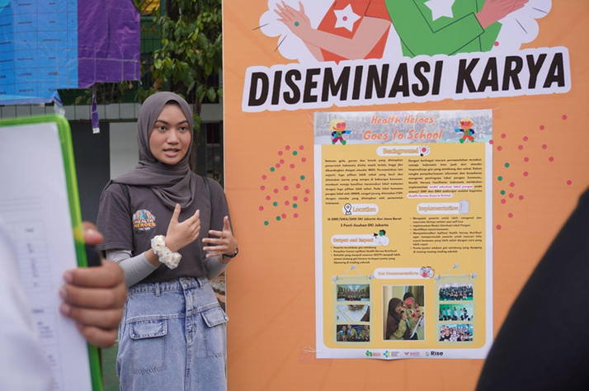

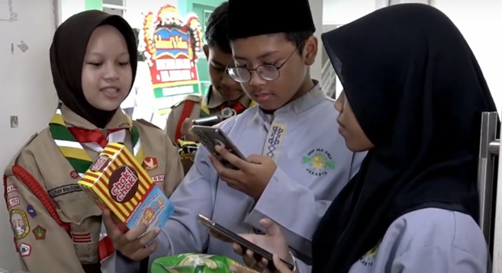


140,000
web users reached
Youth as Consumers (Indonesia)
GUIDING FOOD CHOICES - THE FOOD INVESTIGATOR GAME
Institutional Advocacy
Partnering with government to improve food labelling, enforce rules, and support healthier food choices.
Youth Advocacy
Training young people to push for better food labeling and healthier school and community food options through workshops and peer learning.
Health Heroes App and Campaign
Using digital tools to help teens learn about Front-of-Package Labels (FOPLs) and make nutrition choices easier.
Retail Ranking System
Allowing teens to rate retailers on their healthy snack options, and prompting vendors to offer healthier products.

Slide 7
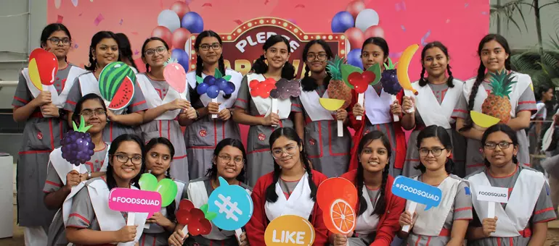
Youth as Consumers - Bangladesh
GUIDING FOOD CHOICES - Bhalo Khabo Bhalo Thakbo - Live Well Eat Well
Pledges to Action: Adolescents pledged to use their pocked money to eat healthier.
Digital Engagement: Social media, online contests, radio, especially during COVID-19
Interactive Learning: E-learning platform with videos, quizzes, games, badges, and certificates
Youth Leadership: Nutri-Leaders Hunt identified and built nutrition leadership and advocacy skills
Networks & Influence: Celebrities, partners, school clubs, and youth networks amplified messages.
1 million
youth pledges

Slide 8

Youth as Consumers - Pakistan
SUPPORTING NATIONAL FOOD SYSTEM/ADOLESCENT NUTRITION POLICIES.
A study conducted with Aga Khan University generated evidence and a better understanding of adolescent food consumption behaviours.
GAIN also worked with the Government of Pakistan, WHO and UNICEF to prepare a adolescent nutrition strategy and operational plan.

Slide 9
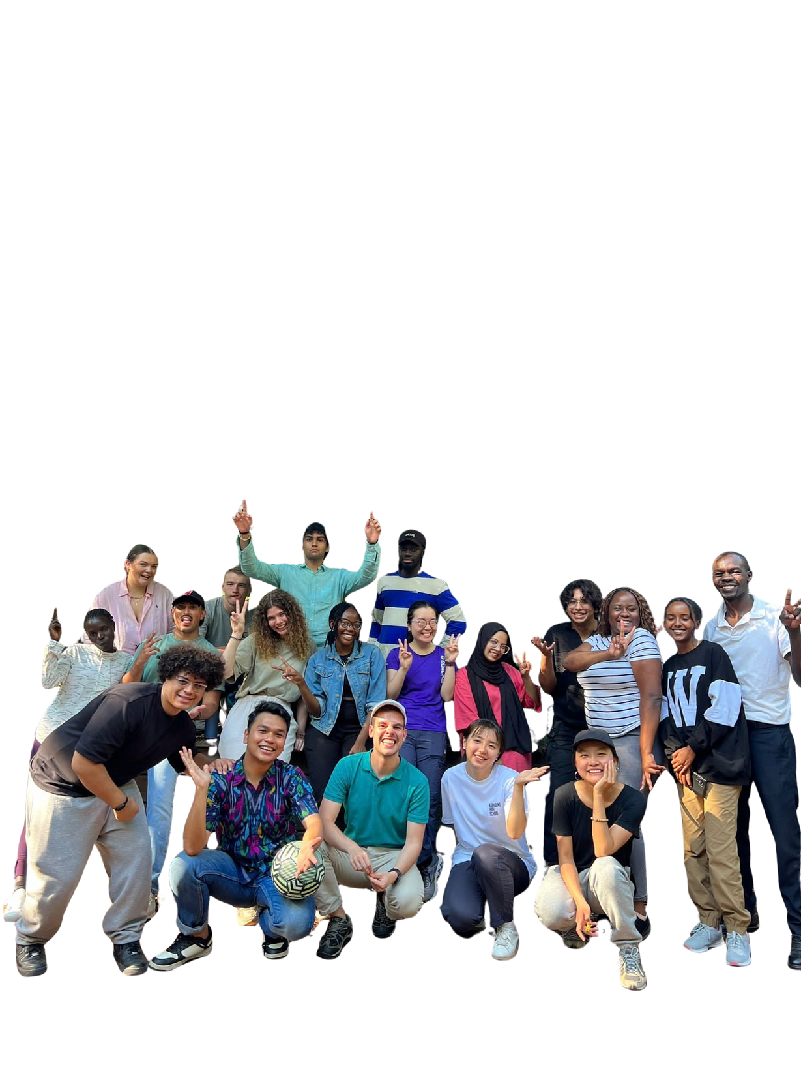
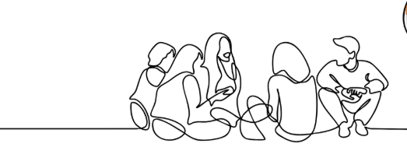
Youth as Changemakers
ACT4FOOD
International youth movement founded by young people in 2021, supported by GAIN. Co-designed the Youth Leadership Initiative.
Youth leaders work together on three collective action campaigns: School meals, indigenous foods and MNCs in food systems. They lead projects in their countries, and participate in global events like UNFSS and AFSF.

Slide 10
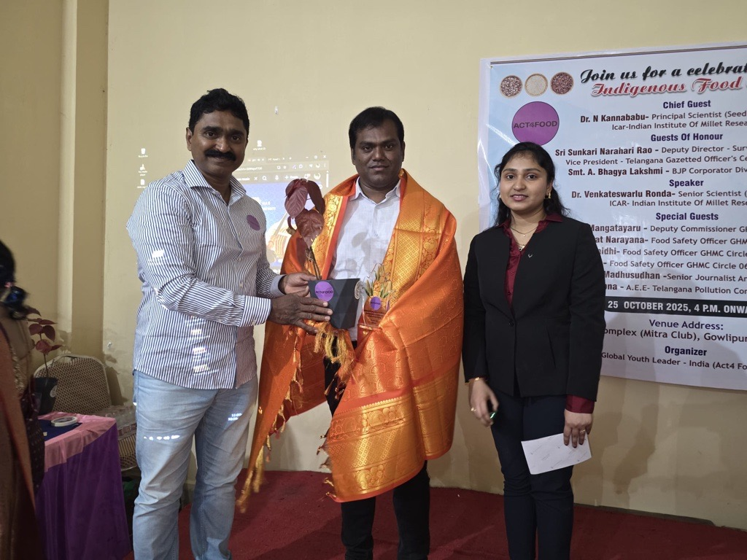
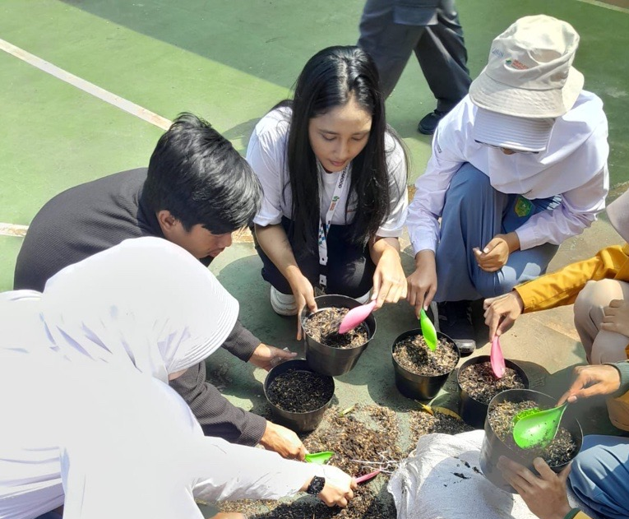
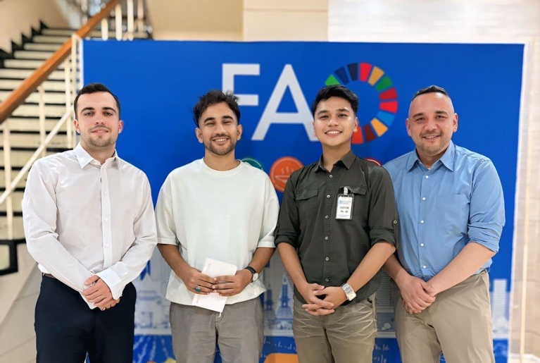
Youth as Changemakers
CAMPAIGNS
ACT4FOOD – Asia Youth Leaders
China
Hong Kong
Collaborated with the Good Food Fund to produce evidence-based content highlighting initiatives driving positive change across China's food system
Hosted a panel discussion at a plant-based restaurant
Discussed the future of food: building a regenerative food system in Hong Kong
India
Community Nutrition & Kitchen Garden Campaign in Hyderabad Telangana
Educating women and families about the nutritional value and cultural importance of indigenous foods
Promoting awareness of indigenous and traditional foods among younger generations through a dedicated podcast called “食肆” (Shísì, a genre refers to a traditional, casual place for eating and socializing)

Slide 11



Youth as Changemakers
CAMPAIGNS
ACT4FOOD – Asia Youth Leaders
Nepal
Actively engaging 50 indigenous women and youth through consultations, capacity-building trainings, and advocacy
Comprehensive management plan for indigenous foods, currently being submitted to local government
Indonesia
Founded Health Heroes Indonesia: young people's movement to be more critical and responsible for their health
Pakistan
GreenClassrooms Project: an initiative dedicated to empowering educators with the tools to promote sustainable living and address poor waste management practices in under-resourced schools
Urban farming in schools in Jakarta

Slide 12
Youth as changemakers (Bangladesh) ​
YOUTH VOICES PROJECT- ENGAGING YOUTH IN
FOOD SYSTEMS POLICY
2
55
47
3
Community Level Training
TOT
Facilitators
1458
40
214
Participants
Districts
out of 64
Collective Action
45.5%
Female Participation
54.5%
Male Participation

Slide 13
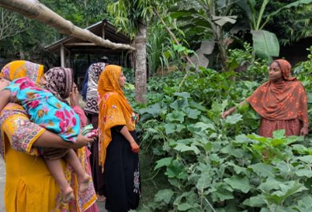
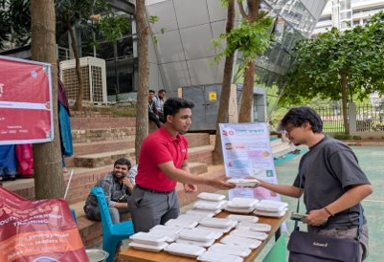
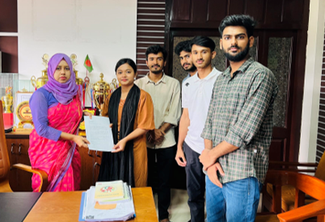
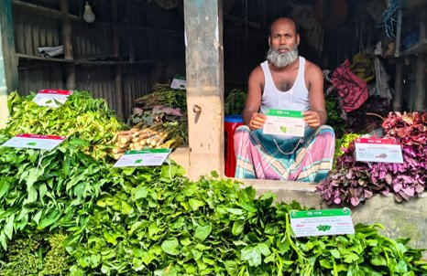
Youth as changemakers (Bangladesh) ​
COLLECTIVE ACTION
BANGLADESH
Youth-led Collective Actions under 11 themes
Including promoting healthier diets, improved school food environments, maternal nutrition, nutrition gardens, food safety awareness etc.
Organized over 800 events including courtyard meetings, campaigns, seminars, public forums and policy dialogues.

Slide 14
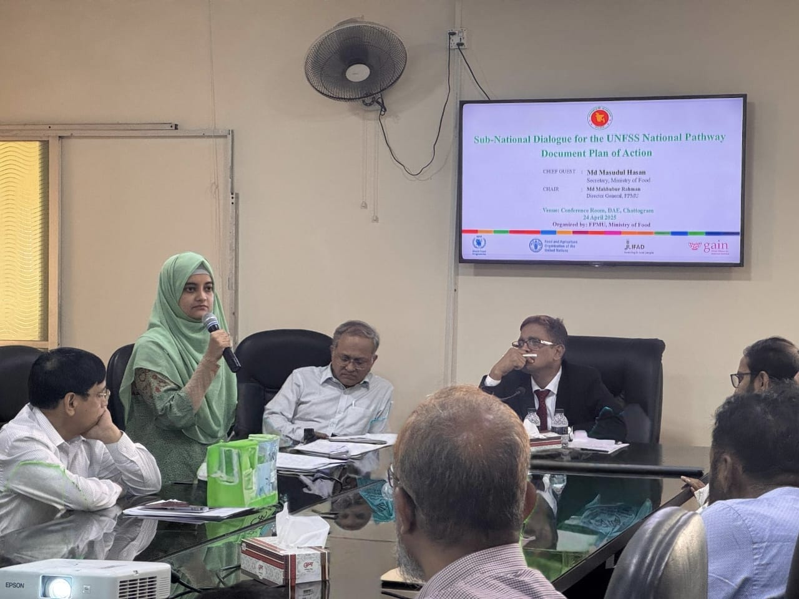


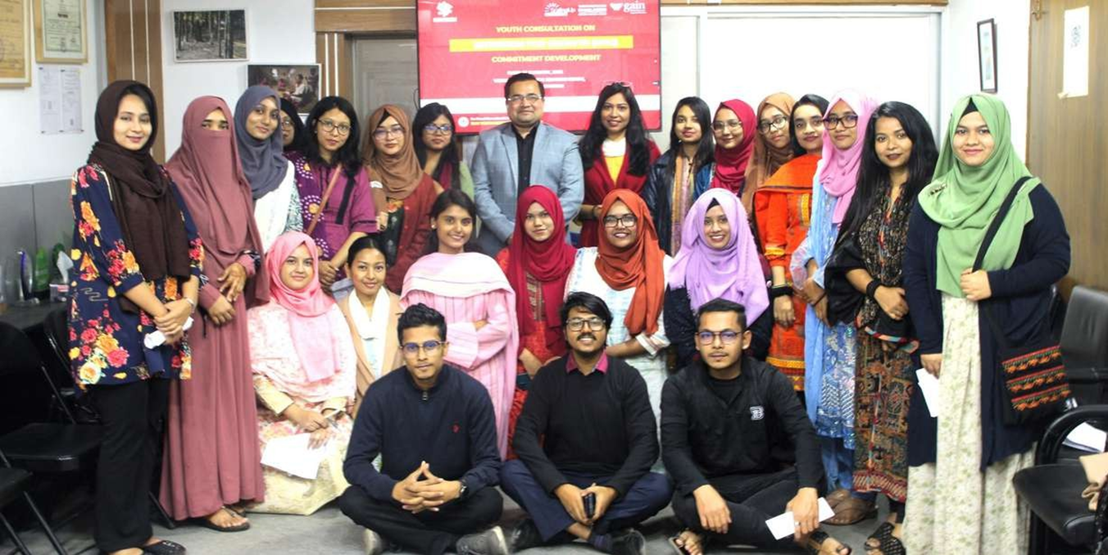
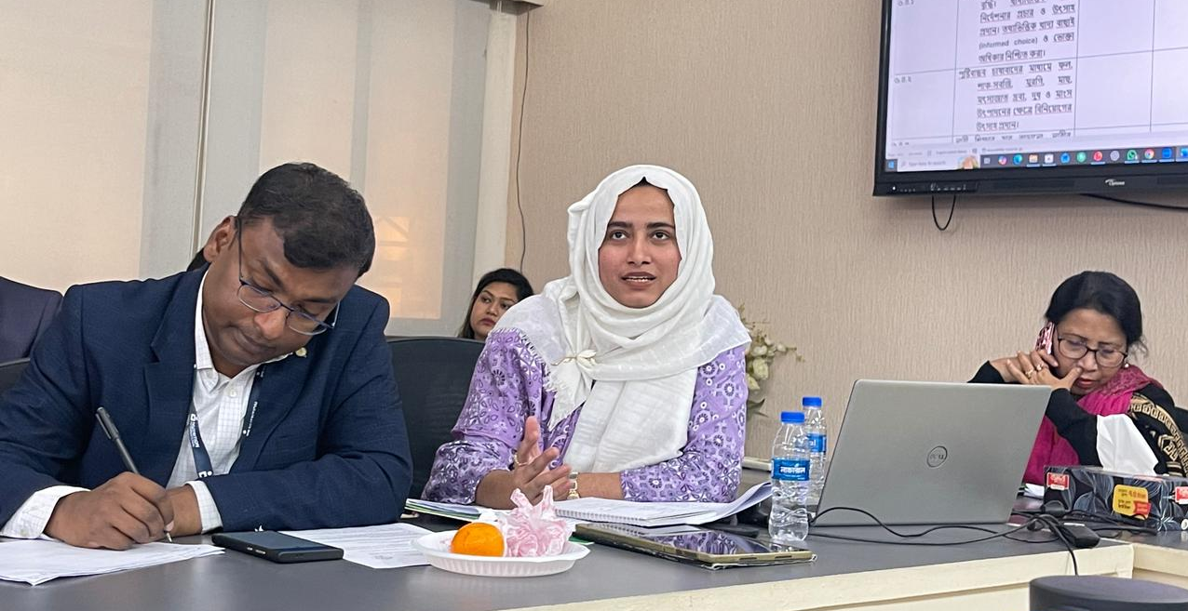
COP
UNFSS
POLICY ENGAGEMENT
N4G
NATIONAL NUTRITION POLICY

Slide 15
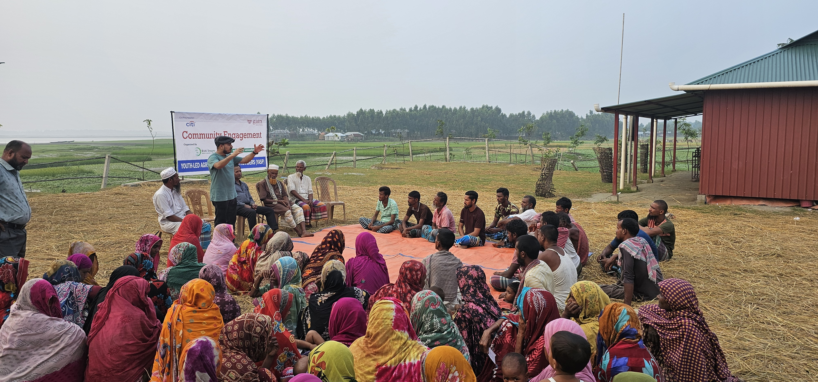
Youth as workers (Bangladesh) ​
YOUTH-LED AGRICULTURAL SERVICE PROVIDERS (YASP)- TURNING RURAL YOUTH INTO AGRI-ENTREPRENEURS
A market-driven, technology-enabled pathway from smallholder farming to sustainable enterprise, piloted 2023–2025 across 4 districts of Northern Bangladesh. Supported by Citi Foundation Global Innovation Challenge in 2023.
YASP meaningfully engaged low-income rural youth especially young women in agriculture, turning farming into a viable, market-driven business through modern farming training, including soil testing facilities, AWD, entrepreneurship development, and stronger farm-to-market linkages.
REACH
15,000
6,000
Farmers trained
(73% women)
Trained in entrepreneurship
& financial literacy (75% women)
75
150
Youth-led SMEs newly created
New jobs created in agri-food
value chain

Slide 16
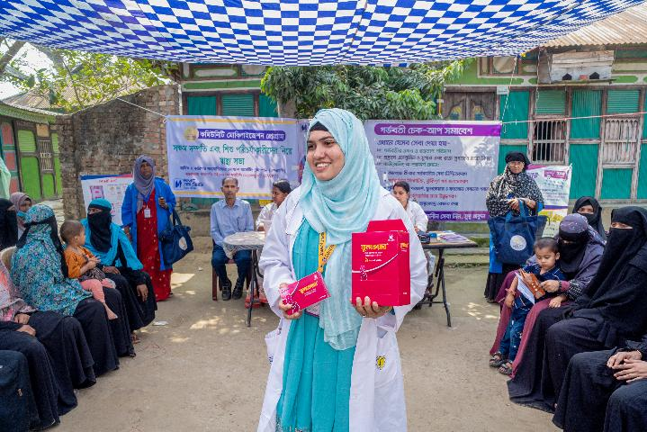
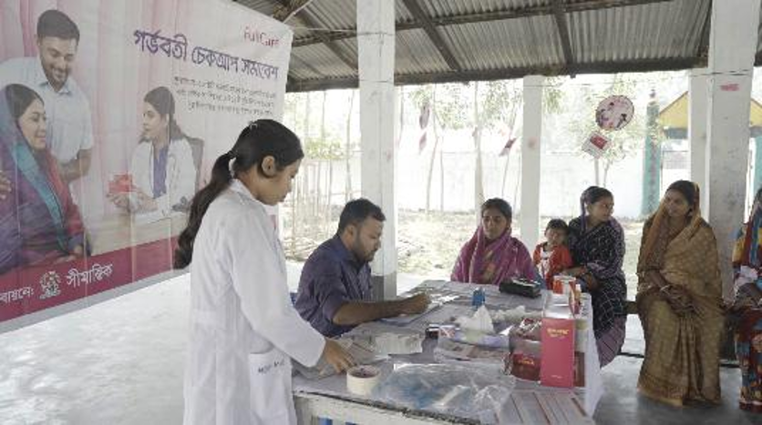
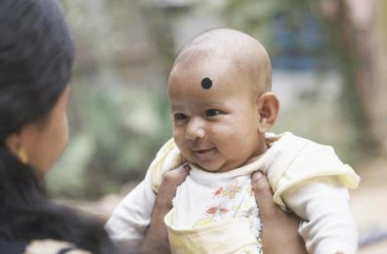
Youth as workers (Bangladesh) ​
A SUSTAINABLE SOCIAL BUSINESS MODEL FOR DELIVERING MULTIPLE MICRONUTRIENT SUPPLEMENTS (MMS) TO PREGNANT WOMEN IN BANGLADESH
MMS intervention is supported by Children’s Investment Fund Foundation (CIFF) and implemented by the Social Marketing Company (SMC) with support from GAIN and Sight and Life (SAL)
✓
First LMIC Country Produced Multiple Micronutrient supplement (MMS) Following UNIMMAP formula produced by Bangladeshi pharmaceuticals company, Renata Ltd.
✓
Around 13,000 Local pharmacy business outlets known as Blue Star Providers (BSP) delivering the largest social business model.
Sales by Female Entrepreneur – Gold Star Member (GSM)
✓
More than 4,500 Women entrepreneur, in 153 sub districts communities covering one third of the country.
✓
119 million MMS tablets sold throughout the Bangladesh reaching 1.3 Million pregnant women since 2021
✓
Strategic partnership with Government of Bangladesh (GoB) supporting the enabling environment.
BSP and A FullCare Baby

Slide 17
INNOVATION COMPETITIONS & HACKATHONS
EAT RIGHT YOUTH HACKATHON UTTARAKHAND 2026 (INDIA)
The Eat Right Youth Hackathon – Uttarakhand 2026 (ERYH) stands as a landmark state-wide movement born out of a simple but radical premise: What if the answers to the toughest public health and nutrition crises are already sitting in our college classrooms?
This initiative bridges the gap between youthful creativity and systemic execution, aligning directly with the vision of the Food Safety and Standards Authority of India's (FSSAI) Eat Right India movement.
13
Districts in Uttarakhand
69%
Of all participating innovators were young women
3
Pillars: Eat Safe, Eat Healthy and Eat Sustainable
6
Winning teams from 387 concepts

Slide 18
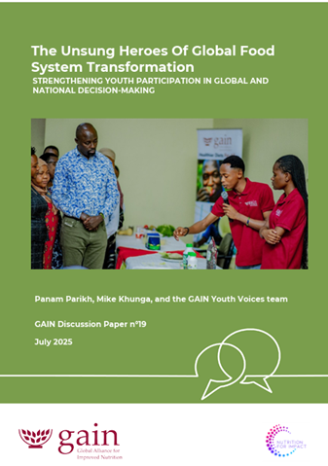
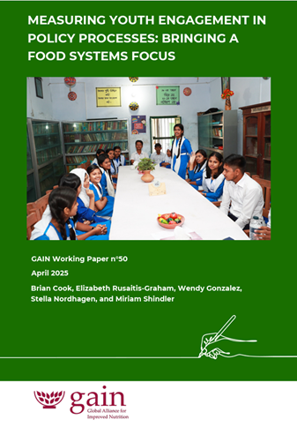
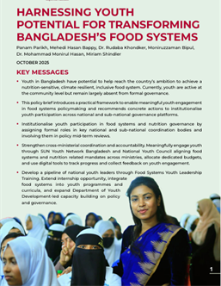
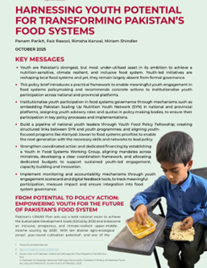
Contributing to evidence on youth in food systems

Slide 19

Private sector tools for building demand for nutritious foods

Slide 20
Context – Demand creation in Asia
1.9 billion people in Asia unable to afford a healthy diet.
PERSISTANT UNDERNUTRITION
RISING NUTRITION TRANSITION
Hunger is falling regionally, but progress is uneven Asia-Pacific is still not on track for 2030 nutrition targets.
Southern Asia hosts the majority of the region's stunted (55.9M) and wasted (25.2M) children.
Only about one-third of children aged 6–23 months and two-thirds of women meet minimum dietary diversity worldwide.
Diet affordability has improved in Asia since 2022, but remains out of reach for hundreds of millions.
Global adult obesity nearly doubled its rate of rise: 12.1% (2012) → 15.8% (2022), alongside growing anaemia in women.
Ultra-processed food consumption is climbing sharply across the region Westernised shift toward ultra-processed, higher-fat diets.
Rising incomes expand UPF purchasing power, while for lower-income groups UPFs act as cheap calorie substitutes for fresh food.
Sources: FAO/IFAD/UNEP/WFP/WHO, State of Food Security & Nutrition in Asia-Pacific (2025) and SOFI 2025; Lu et al., Foods (2025); Lee et al.,

Slide 21



Building demand for nutritious foods:
THREE tools from private sector practice
1
Build a platform
Benin
Uganda
Kenya
GAIN built recognisable consumer platforms that could adapt across markets and carry more than one nutritious food, expressed through brands, brand characters and recurring storylines.

Slide 22


Building demand for nutritious foods:
THREE tools from private sector practice
2
Lead with emotion
More flavour more life
Tap into identities, values and aspirations that already resonate with people to make healthier diets desirable. Emotion creates relevance.
Nutrition and taste provide the reasons to believe, reinforced through recipes, seasonal tips and cooking demonstrations

Slide 23
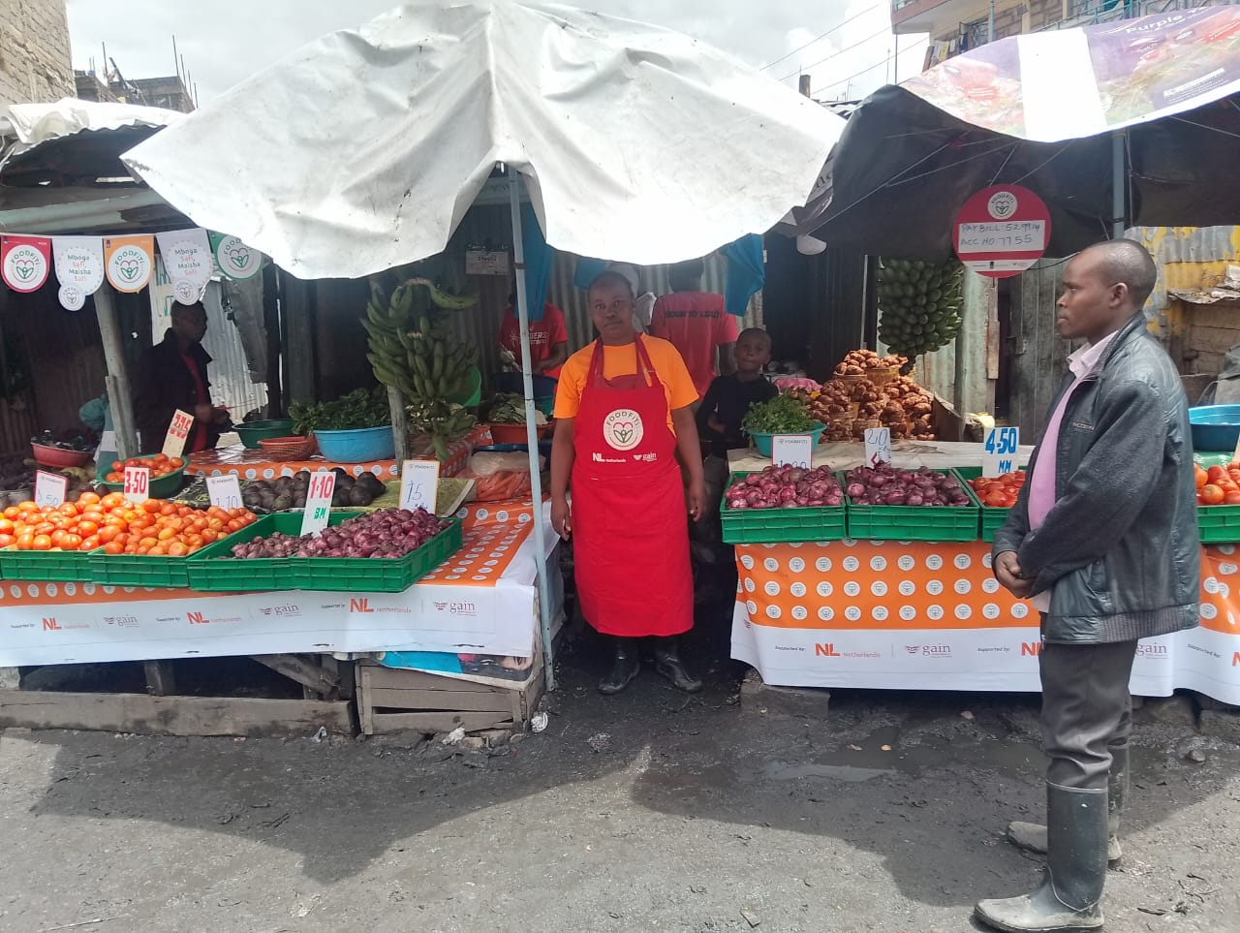
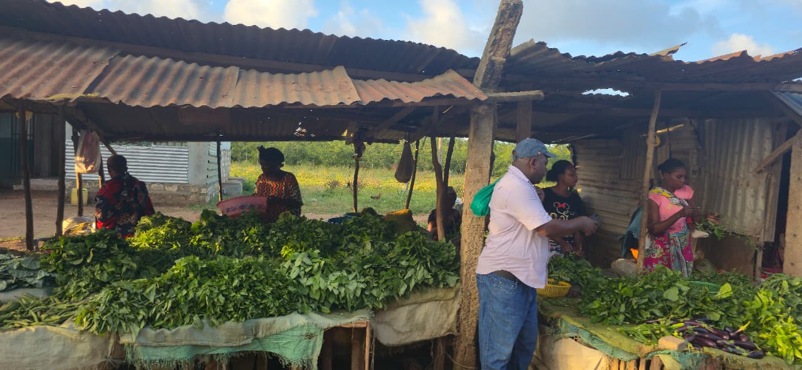
Building demand for nutritious foods:
THREE tools from private sector practice
3
Retail FOCUS
Research in Kenya showed that freshness, proximity and safety shape purchase. So the platform was carried into the places where daily food choices are made.
Over 15,000 last mile vendors carry the brand and pass on its messages. The distributors behind them are trained on the same messages.
FoodFiti branded last mile vendor
Comparison vendor
Over 24 million consumers reached across six countries in the last year
Vegetables in Kenya, Uganda and Benin · Animal source foods in Mozambique

Slide 24
Scaling demand generation into industry practice
People at the centre
Design with the people, not for them. Start with tensions, aspirations and trade-offs shaping daily food choices, not only from the nutrition gap.
Build shared platforms
Create recognizable platforms that can carry multiple foods across products, partners and channels. Build on existing rather than starting again for every project or food. GAIN's platforms are open, and we are not the only ones building them.
Invest across the demand pathway
$
Fund the full journey from consumer insight and creative development to media, point-of-choice activation, measurement and adaptation.
Commit long enough to compound
Keep the platform consistent long enough for recognition, trust and routine choice to grow. Adapt the execution without continually replacing the core idea.
Scale will come from more of the industry backing fewer consumer platforms, consistently,
from media to the last-mile vendor.

Slide 25
A case study from Indonesia: Super Rice

Slide 26
Super rice – enhancing vegetable consumption in Indonesia
Shift: Move vegetables to the centre of the plate, as ‘enhancer’ of rice, from a marginal role on the side
Insights:
  Rice is at the heart of the plate, ‘lauk’ adds taste and texture, vegetables have become marginal
  Vegetables perform poorly on convenience, the biggest driver for food choices
  Every household has a rice cooker
Idea: Transform your everyday rice into ‘super rice’
  Add freeze-dried vegetables and spices, straight into your rice cooker
  Super rice = convenience + taste + variety + benefits of fibre; that ‘makes life flow smoothly’
  Will need to improve availability of freeze-dried vegetables
Indonesia Estimated Rice and Vegetables Consumption Per Capita Per Day (gm)
  Source: BPS, Susenas Data; https://sustainablerice.org/sustainable-rice-consumer-survey-indonesia/; https://southeastasia.rikolto.org/projects/sustainable-and-inclusive-rice-based-food-systems-in-Indonesia; M Khairunnisa et al 2022 IOP Conf. Ser.: Earth Environ. Sci. 1024 012081; Azimatul Amini et al. Sociodemographic Determinants of Fruit and Vegetable Consumption in Indonesia: Insights from the 2023 Indonesian Health Survey. Available at https://www.medrxiv.org/content/10.1101/2025.07.22.25331981v1.full.pdf.
Notes:
Rice is the most important staple consumed in Indonesia, with almost 100% of population consuming it at least 5 times a week
On the other hand, the consumption of vegetables is much less than the recommended daily consumption levels by the Ministry of Health
Recommended consumption levels for adults is ~400gm of fruits and vegetables per day, of which ~250gm is supposed to come from vegetables
However, actual consumption is estimated to be between ~70gm to a little over ~100 gm per capita per day
It is estimated that over 97% of Indonesians consume less than the recommended dietary requirement of vegetables
Therefore, encouraging adoption of relevant super rice offerings, incorporating vegetables and rice, can significantly improve vegetable consumption
For example, incorporating a 20% addition of vegetables by weight (40 – 60gm) into a relevant super rice recipe, could result in a potential 40-60% increase in daily vegetable consumption

Slide 27
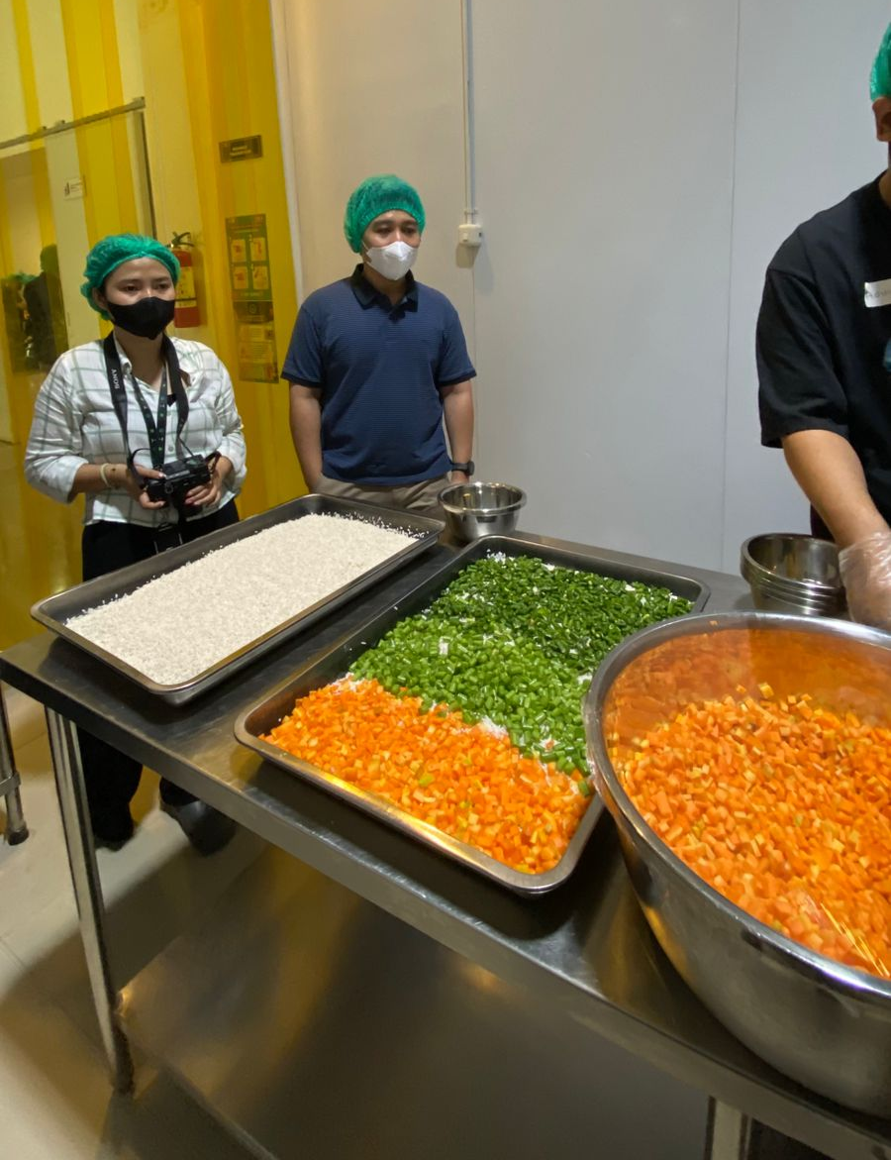
The pilot was conducted with the Government School Meals Programme in Bogor City
  Bogor City Health Office welcomed the Super Rice concept, highlighting the potential for the following three benefits:
    Streamlining production time (efficiency)
    Maintaining or improving nutritional quality
    Ensuring hygiene and compliance with HACCP standards
  The Satuan Pelayanan Pemenuhan Gizi (SPPG) appointed one kitchen to serve as the location for the pilot implementation
  The initiative will be framed within the ambit of the B2SA campaign (Beragam, Bergizi, Seimbang, dan Aman), led by the National Food Agency (Badan Pangan Nasional)

Slide 28
The pilot was monitored and evaluated along four key parameters
1. Ease and Efficiency of Operationalization
2. Compliance with Key Requirements
1A
1B
1C
2A
Recipe Development as per Nutrition Guidelines
Cooking Equipment
Production Process
Food Safety and HACCP Guidelines
Pre-production Simulation and Refinement
Direct observation and Testing
Full Real Simulation and Learnings
Training and Direct Observation
Testing, calibrating and finalizing the recipe(s) for Super Rice
Suitability of type, quantity, & condition of cooking equipment
Feasibility and efficiency of end-to-end production process
Checking compliance with food safety and HACCP guidelines
3. Consumer Adoption and Acceptance
4. Economic Case for Scaling Up Super Rice Implementation
3A
3B
4A
4B
Taste and Recipe Acceptance
Food Waste
Cost of Ingredients vs. Budget Ceiling
Operational Differences and Related Cost/ Benefit Impact
Survey of OPD Panelists and Students
Direct observation and Recording
Data Collection from SPPG and Analysis
Inputs from Full Pilot Simulation and Analysis
Feedback on taste, texture, aroma, visual appeal, portion sizes etc.
Super rice waste as a proxy for beneficiary preference
Comparison of costs of Super Rice menu vs. allowed budget ceilings
Evaluation of costs/ benefits of Super Rice operations vs. regular operations

Slide 29
In summary, we recommend that Super Rice is feasible to be introduced and scaled up as an integral part of the School Meals Programme across SPPGs
Operationally Feasible
  Super Rice was successfully produced in real operational situation across 5 cycles, with over 1,625 portions per cycle
  100% of OPD panel members consider this as a feasible option as a part of the School Meals Programme (MBG) menu and replicable in most central kitchens, using mostly existing equipment, ingredients and personnel
Economically Viable and Comparable
  Cost of ingredients are within the budget ceiling for Junior High School students, and also potentially for Primary School students if portion size adjustments can be considered in line with national dietary guidelines for this cohort
  Operational costs are similar to conventional rice cooking
  No major equipment or capital expenditure required (e.g. only ~IDR 500K – 1.5Mn for a cooking thermometer)
  Limited to no cross-subsidies are needed to include this as a part of the menu options for the School Meals Programme
Decent Acceptance by OPD Panellists and Students
  Super Rice was well accepted by the 28 OPD panellists across parameters such as visual appeal (53% positive), texture of the rice (~96% positive), flavour balance (~100% positive) and portion size (~96% appropriate)
  Based on the survey of Junior High School students, the results for acceptance of Super Rice are positive across most parameters, such as taste (~71% positive) and aroma (46% positive and additional 38% neutral)
    Visual appeal is rated neutral (26% positive and another 40% neutral)
    While green beans is rated low, after education, >66% students mentioned that they will eat it given the benefits
Meets Nutrition Guidelines
  Maintains the nutrition requirements – main ingredients (rice and vegetables) required are similar in volume and nutrition levels
  There is some anecdotal evidence (based on observation of food wastage) that students are wasting lower quantities of vegetables given that these are mixed with rice, as compared to other conventional menus – possibly resulting in improved delivered nutrition
    This needs to be further validated through more structured observations

Slide 30
Key learnings for sustainable, nutritious school meals
Food Safety
Nutritional Security
Climate Response
Multi-Sectoral Collaboration
Aflatoxin risk drives up to a third of stunting-linked disease burden, and climate change is making it worse.
Risk concentrates in transport, storage & processing, the least-studied, least-monitored part of the chain.
48% of Indonesians cannot afford a healthy diet; farm policy still favours staples over produce
Meal quality alone isn’t enough. Environment assessments (NEAT-S) show canteens & curricula matter too
Reformulating a familiar staple (Super Rice) met nutrition guidelines with near-universal acceptance
Climate and nutrition policies aren’t yet pulling in the same direction, diet-shift incentives are missing
Procurement timed to seasonal, climate-smart production is a proven fix
Indonesia already has the coordination architecture (Kemenko Pangan, Bappenas, UNFSS pathway), the gap is follow-through
Only 11.5% of global procurement evidence covers Asia, Indonesia’s own pilots can help close that gap
Pastorino et al., 2024; GAIN & GCNF PIFP review, 2026
Food Systems Dashboard 2025; UNICEF NEAT-S; GAIN Policy Coherence Diagnostic 2025; GAIN Super Rice pilot
GAIN Policy Coherence Diagnostic 2025; Pastorino et al., 2024; GAIN & GCNF PIFP review, 2026
GAIN Policy Coherence Diagnostic 2025; GAIN & GCNF PIFP review, 2026

Slide 31
Thank you

